Slide 1
Wet Moat
Red Dhole 1 Exhibit
Legend
= Water Trough
= Horizontal Logs
= Standing Logs
= Boulders
= Zipline
= Cave
2.2m

Slide 2
Zone A
Zone C
Zone D
Wet Moat
Red Dhole 1 Exhibit
Zone B
Zone E
2.2m
Notes:
1.) Probably a good idea to describe how the zones differ from one another; for e.g., what does Zone D encompass and how is it different from Zone E, etc.

Slide 3
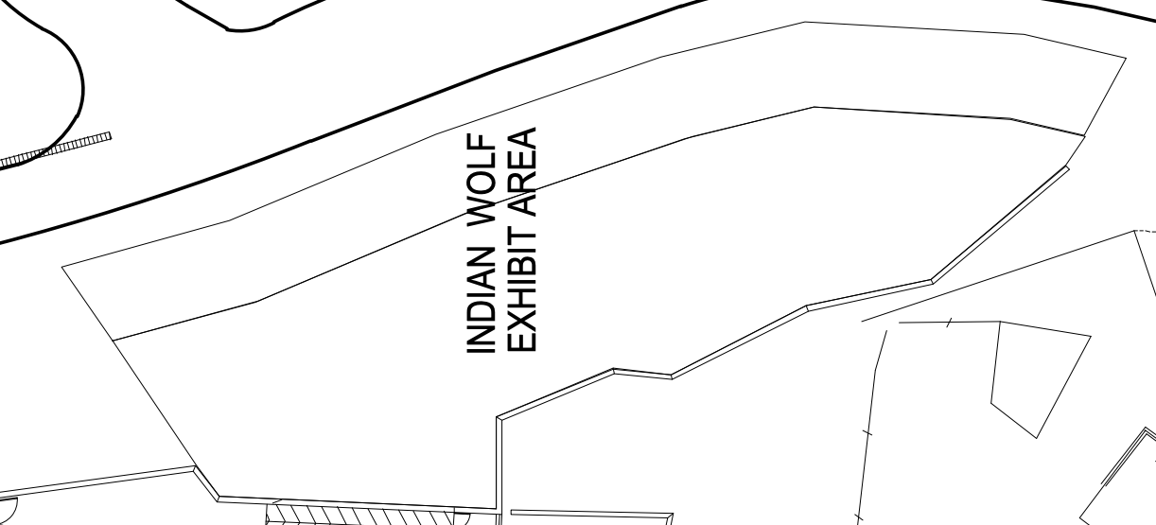
Legend
Tram Route
Dry Moat
Legend
= Water Cascade
= Horizontal Logs
= Boulders

Slide 4
Tram Route
Dry Moat
Legend
= Water Cascade
= Horizontal Logs
= Boulders

Slide 5
Tram Route
Dry Moat
Zone E
Zone D
Zone C
Zone A
Zone B
Notes:
1) OOS ~ Env * Dev
2) A% ~ Env * Dev
3) SPI ~ A%*Dev*Env

Slide 6
Legend
6.5m
= Water Trough
= Pool
= Water Cascade
= Horizontal Logs
= Standing Logs
= Boulders
= Platform
= Zipline
12m
Glass
9.5m
19.5m
Exhibit
10.5m
5.5m
5.5m
19m

Slide 7
Legend
= Water Trough
= Pool
= Water Cascade
= Horizontal Logs
= Standing Logs
= Boulders
= Platform
= Zipline
Glass
Exhibit

Slide 8
Zone E
6.5m
12m
Viewing Gallery
Zone A
9.5m
19.5m
Zone B
Tiger Exhibit
Zone D
10.5m
5.5m
5.5m
Zone C
19m

Slide 9
